Slide 1
Chapter 6: Trees
Binary Trees, Binary Search Trees, Balanced trees, general trees, multi-way trees, tries, heaps

Slide 2
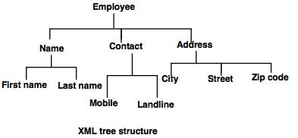
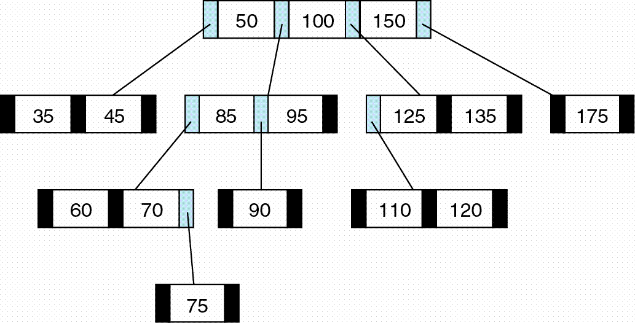
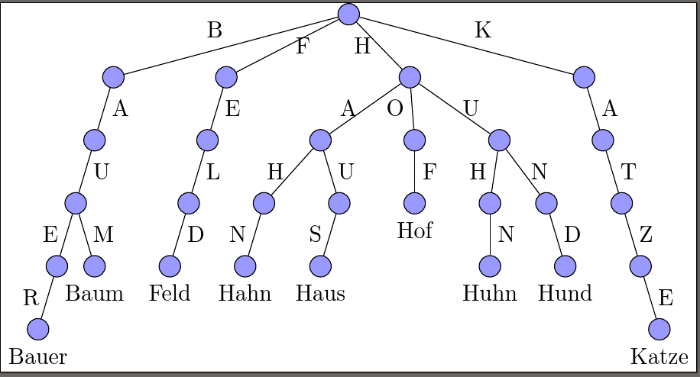
Learning Outcomes
General Trees
Multiway Search tree
B-Tree
Tries

Slide 3
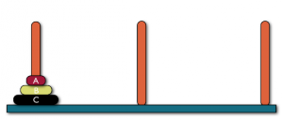
General Trees
A General tree has no limit to the number of branches from a node, nor need it have an specific order to the branches.
Applications include game trees used by game playing programs to investigate possible moves.
Tower of Hanoi with 2 discs.

Slide 4
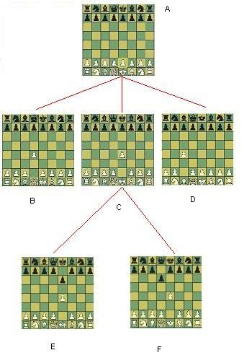
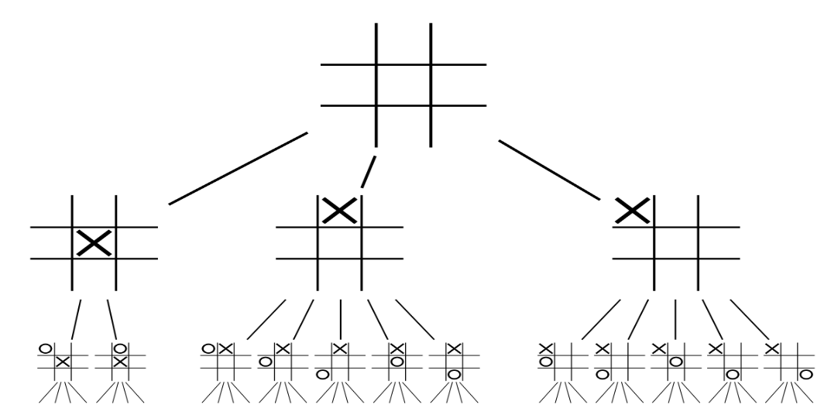
General Trees
Chess, Tic-tac-toe programs each node would be a board position with branches representing possible moves from that position to a new position (child node). Branches from the next level of nodes would represent possible countermoves etc...
https://www.sites.google.com/site/qgchess/chess-algorithms

Slide 5
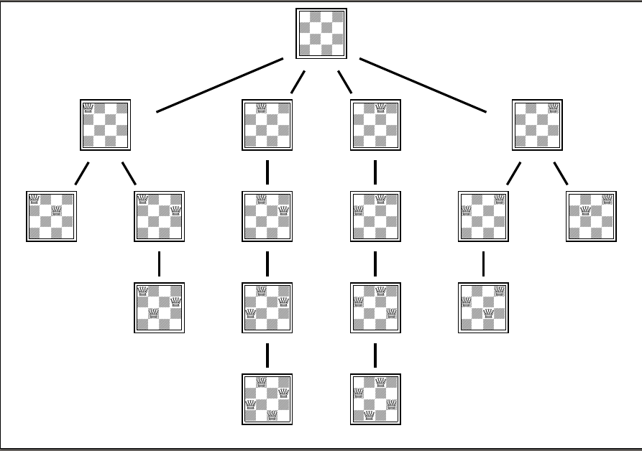
General Trees
4 Queens problem
In chess programs each node would be a board position with branches representing possible moves from that position to a new position (child node). Branches from the next level of nodes would represent possible countermoves etc...

Slide 6
General Trees
A general tree can be represented by
Leftmost Child - Rightmost Sibling

Slide 7
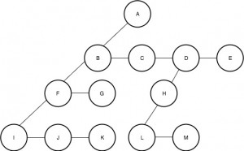
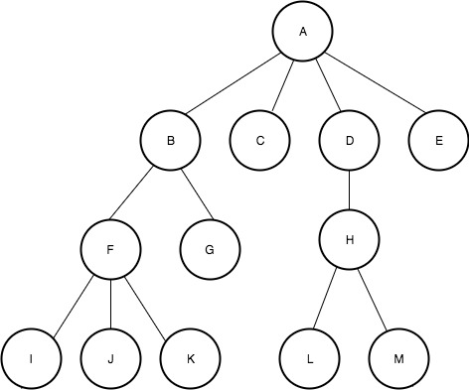
General Trees
Leftmost Child - Rightmost Sibling (LMC-RMS)
Write the declaration for this representation.
An example of a general tree and what it looks like using LMC-RMS representation.
https://www.geeksforgeeks.org/left-child-right-sibling-representation-tree/

Slide 8
General Trees
Algorithms:
Top down: parent to child
Bottom up: child to parent
IsLeaf()
Parent()
Sibling()
Children()
https://www.geeksforgeeks.org/left-child-right-sibling-representation-tree/

Slide 9
General Trees
Algorithms:
Traverse():
From before
Depth First Search :
Breadth First Search : level order
Algorithms later in slideshow.

Slide 10
Other Representations
Array of Parent Pointers
Adjacency list
Array based leftmost child rightmost sibling

Slide 11
Array of Parent Pointers
25
31
6
14
Discuss Algorithms:
Top down: parent to child
Bottom up: child to parent
IsLeaf()
Parent()
Sibling()
Children()
21
93
17
18
19
Nodes
Parent
25 | 31 | 6 | 14 | 21 | 93 | 17 | 18 | 19
- | 0 | 0 | 0 | 2 | 2 | 3 | 3 | 3

Slide 12
Array based leftmost child rightmost sibling
25
Node | LMC | RMS | Parent
25 | 1 | null
31 | null | 2
6 | 4 | 3
14 | 6 | null
21 | null | 5
93 | null | null
17 | null | 7
18 | null | 8
19 | null | null
31
6
14
21
93
17
18
19
Discuss Algorithms:
Top down: parent to child
Bottom up: child to parent
IsLeaf()
Parent()
Sibling()
Children()

Slide 13
Adjacency list
head
25
31
6
14
null
25
31
null
6
21
93
null
31
6
14
14
17
18
19
null
21
null
21
93
17
18
19
93
null
Discuss Algorithms:
Top down: parent to child
Bottom up: child to parent
IsLeaf()
Parent()
Sibling()
Children()
17
null
18
null
19
null
null

Slide 14
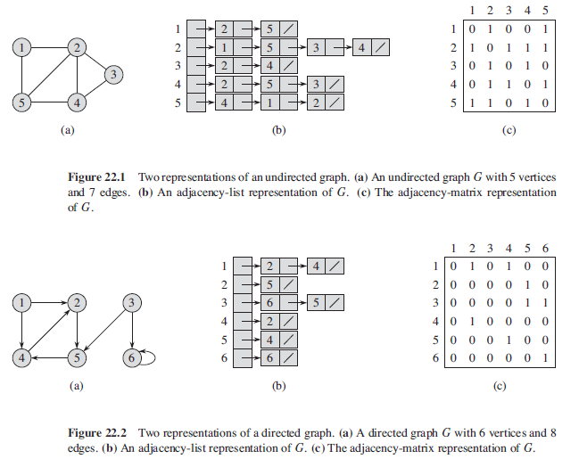
Flashback- to GRAPHS
https://b33angelova.wordpress.com/tag/java-algorithms/

Slide 15
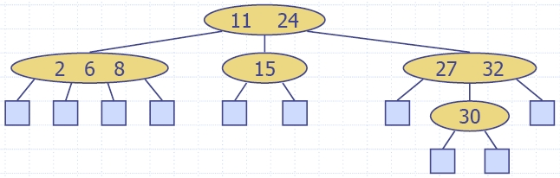
Multi-way search trees.
As a Reminder:
In a binary search tree, each node holds a single value and has at most 2 branches, left tree values < node and right tree values > node.
This can be generalised by allowing more values at each node and more branches to split the descendants into several groups.

Slide 16
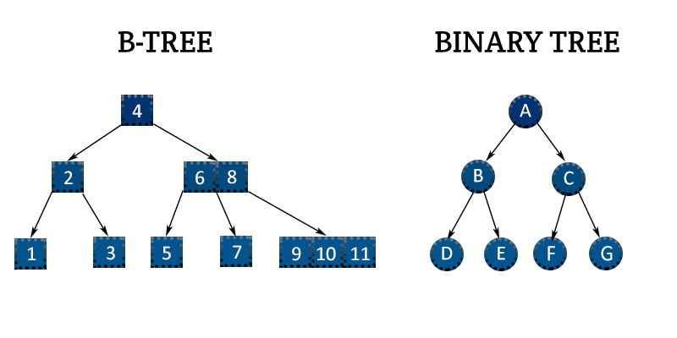
https://open4tech.com/b-tree-vs-binary-tree/

Slide 17
Multi-way search trees.
Example: with up to 2 values in each node, there are up to 3 branches, thus children are split into 3 groups.
The 1st branch is used for values < first node value,
the 2nd branch is used for values > first node and < second node,
The 3rd branch is used for values > second node value
This structure is called a multi-way tree.
A binary search-tree is a 2-way tree. This one is a 3-way tree.

Slide 18
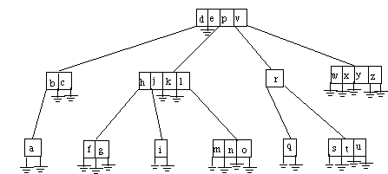
Multi-way search trees.
Q?: Inorder search

Slide 19
B-Tree (balanced multiway tree)
Definition : A B-tree of order m is a general tree satisfying the properties :
- all leaves are on the same level,
- the root has at least 2 children (branches) and at most m children.
- the number of data items stored in each internal node is one less than the number of branches and these values partition the data item that are stored in the children.

Slide 20
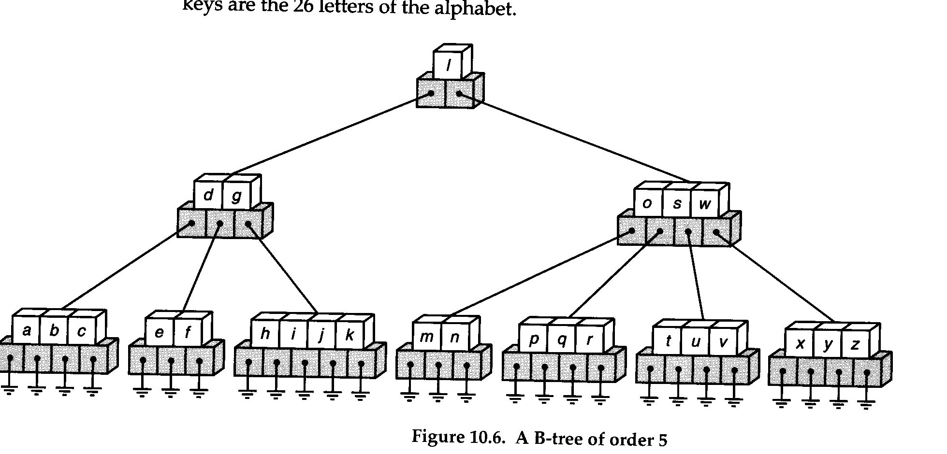
B-Trees

Slide 21
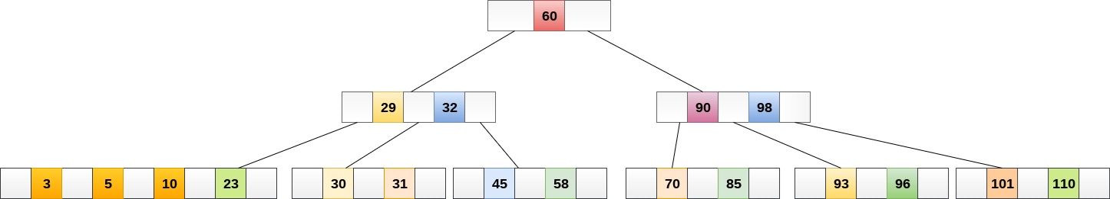
B-Trees
Example : B-tree of order 5 that stores integers
https://www.javatpoint.com/b-tree

Slide 22
Constructing a B-tree of order m.
Begin with a single node and insert values into this node until it becomes full, that is until it contains m-1 items.
When the next item is inserted, overflow! the node is split at median into 2 nodes, one storing items < median and the other storing items > median.
The median itself is stored in a parent having 2 nodes as children.

Slide 23
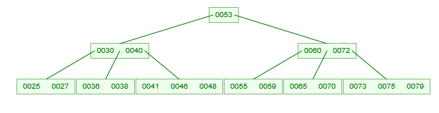
B-Trees
Insert 25, 40, 41, 27, 55, 36, 46, 60, 53, 38, 73, 48, 72, 79, 59, 65, 75, 30, 70
(order 5)
https://www.cs.usfca.edu/~galles/visualization/BTree.html

Slide 24
B-Trees
Insert 25, 40, 41, 27, 55, 36, 46, 60, 53, 38, 73, 48, 72, 79, 59, 65, 75, 30, 70 (order 5)

Slide 25
overflow!

Slide 26
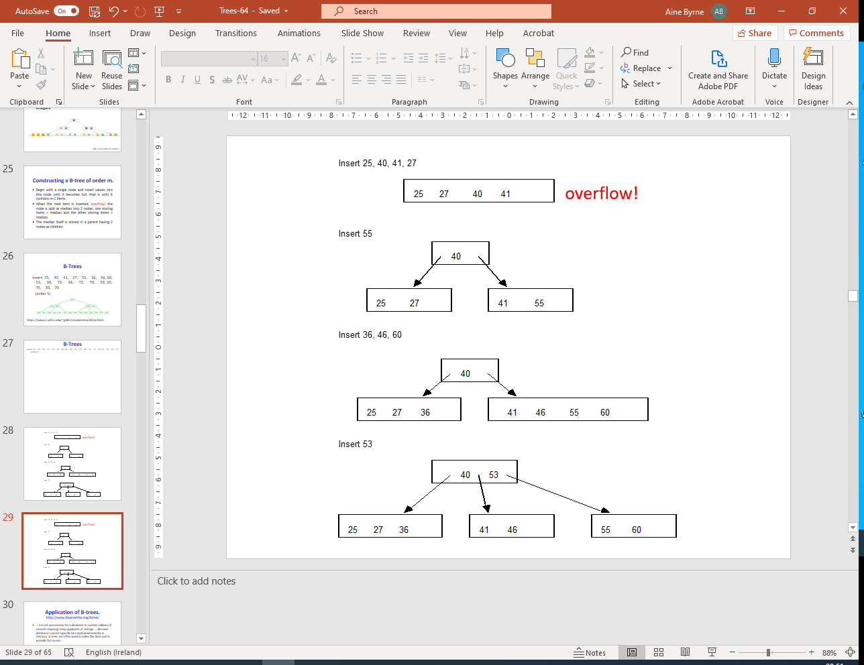
…. 38, 73, 48, 72, 79, 59, 65, 75, 30, 70

Slide 27
Application of B-trees. http://www.bluerwhite.org/btree/
...It is not uncommon for a database to contain millions of records requiring many gigabytes of storage. ...Because databases cannot typically be maintained entirely in memory, b-trees are often used to index the data and to provide fast access.
For example, ..To perform a search for a single key on a set of one million keys (1,000,000), a linear search will require at most 1,000,000 comparisons. If the same data is indexed with a b-tree of minimum degree 10, 114 comparisons will be required in the worst case.

Slide 28
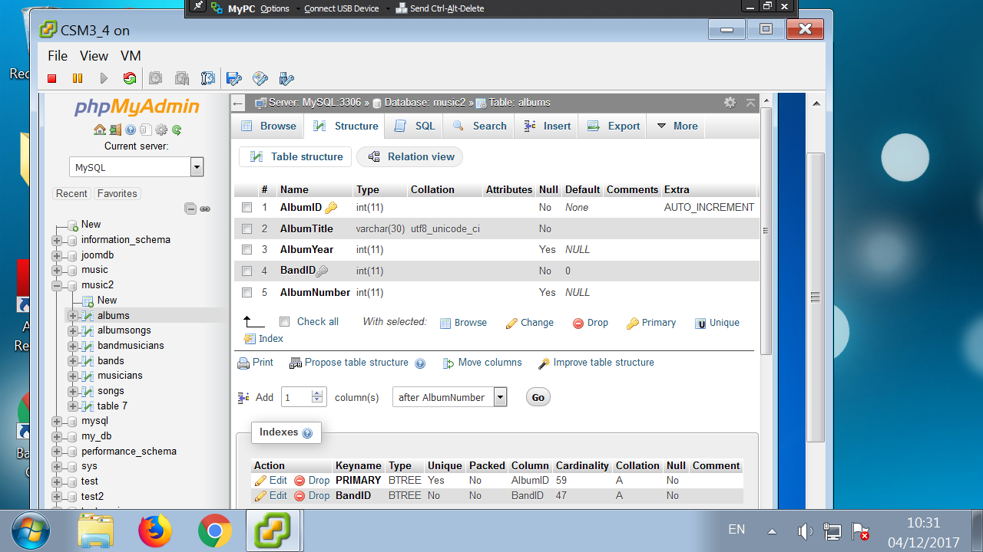

Slide 29
References
SQL Server:
http://www.simple-talk.com/sql/learn-sql-server/sql-server-index-basics/
http://msdn.microsoft.com/en-us/library/ms177443.aspx

Slide 30
Exercises
1. Create a B-tree of order 5 with the following node values.
10, 50, 6, 29, 64, 11, 13, 18, 19, 72, 88, 17, 77, 102, 98
2. Create a B-tree of order 3 with the following node values.
C, O, R, N, F, L, A, K, E, S

Slide 31
More Tree traversals
There are 2 more methods for searching for nodes within a tree :
depth-first search and
breadth-first search.

Slide 32
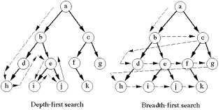
Depth-first search
Depth-first search for trees : Start at the root, visit it. Select one of it's children and visit it and all it's children, and all their children etc... When there are no more children backtrack and visit any other nodes in this way until all nodes have been visited.

Slide 33
Breadth-first search
Breadth-first search : Start at the root, visit it. Then visit all it's children from left to right etc.. , drop a level and visit all nodes in this way until no more nodes to visit.
Algorithms (Year 2)

Slide 34
Depth-First Search
(* Given a general tree and array Visited initially set to false. This algorithm visits all nodes in tree in DFS order*)
1. Form a one-element stack consisting of the root node.
2. UNTIL the stack is empty or all nodes Visited
2.1 Pop the stack; Visited[popped node] = True
2.2 Push children of popped node into the stack
If all nodes not Visited then output: Disconnected Tree

Slide 35
Depth-First Search (Recursive)
(* Given a general tree and array Visited initially set to false. This algorithm visits all nodes in tree in DFS order*)
Initial call: DFS-recursive(root)
DFS-recursive(r) {
visited[r] = True
for all children c of node r {
if ! visited[c]
DFS-recursive(c);
}
}

Slide 36
Breadth-First Search
(* Given a general tree and array Visited initially set to false. This algorithm visits all nodes in tree in BFS order*)
1. Form a one-element queue consisting of the root node.
2. UNTIL the queue is empty or all nodes Visited
2.1 Dequeue the queue; Visited[dequeued node] = True
2.2 Enqueue children of dequeued node into the queue
If all nodes not Visited then output: Disconnected Tree

Slide 37
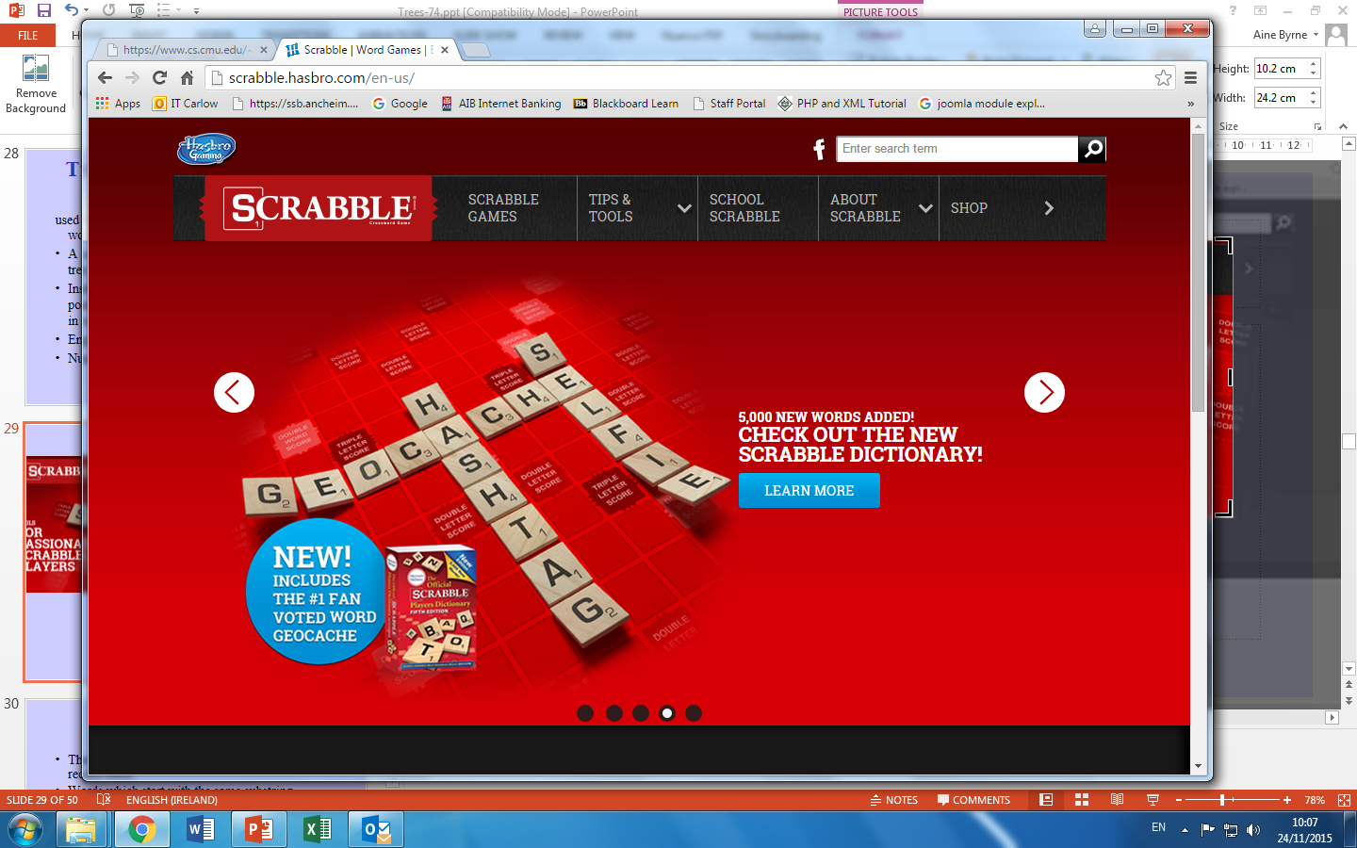
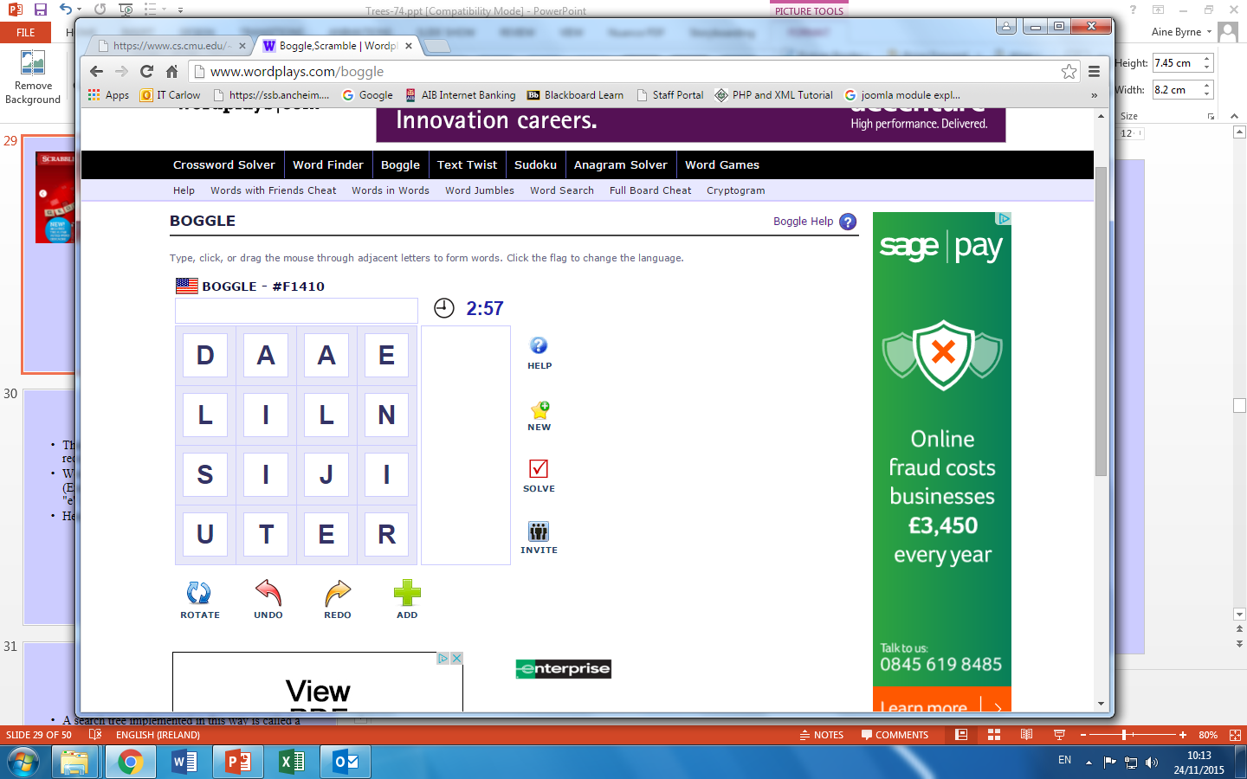
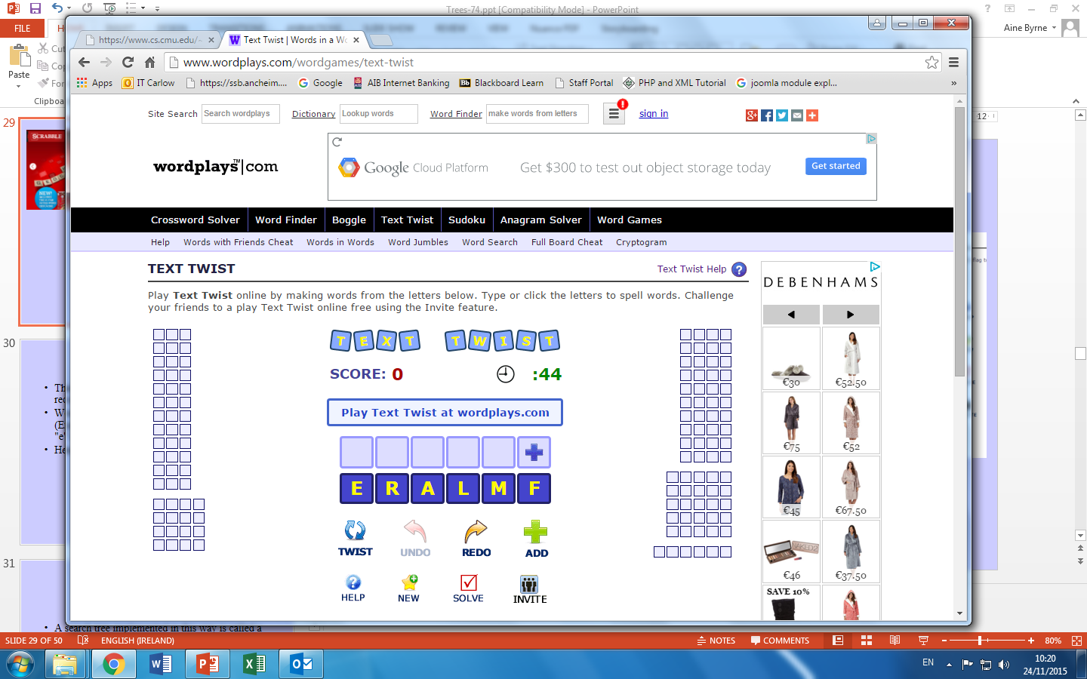
Solving Word Games

Slide 38
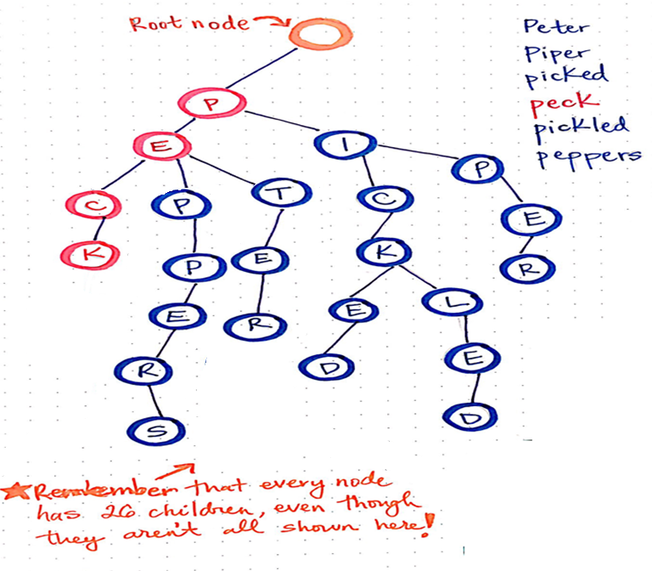
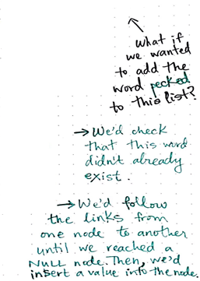
Tries Reference
https://medium.com/basecs/trying-to-understand-tries-3ec6bede0014

Slide 39
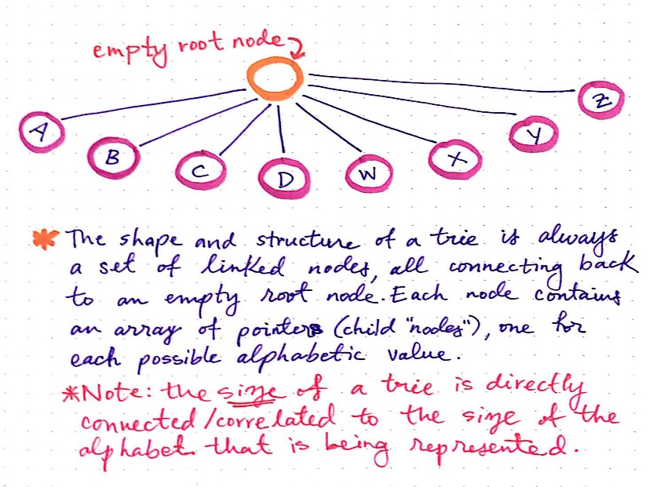
Tries: Lexicographic Search Trees
used for maintaining an efficient index for a list of words.
A search tree need not be implemented as a binary tree.
Instead, each node in the tree can contain m pointers, corresponding to the m possible symbols in each position of the key.
English alphabet => 26 links
Numbers => 10 links

Slide 40
Tries
There will also be an extra pointer to the data record itself.
Words which start with the same substring (Example : new and neo). The common part "n" & "e" is stored only once.
Hence lesser storage space and efficiency
n
e
w
o

Slide 41
Tries
A search tree implemented in this way is called a trie (retrieval).
Instead of searching by comparison of entire keys, a key is considered as a sequence of characters and these characters are used to determine the multiway branch at each step (ie. which pointer to take).
Like thumb indexing a dictionary.

Slide 42
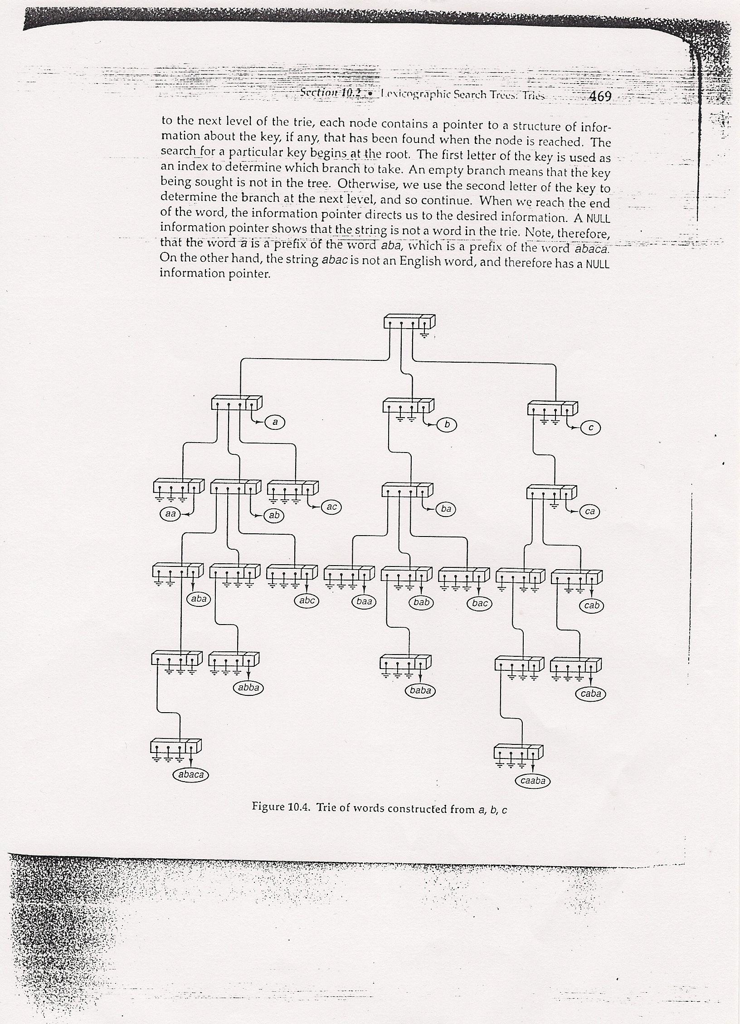
Example: a trie describing the words made up from only letters a,b,c.

Slide 43
Add
PECKED
Thanks Sebastian!

Slide 44
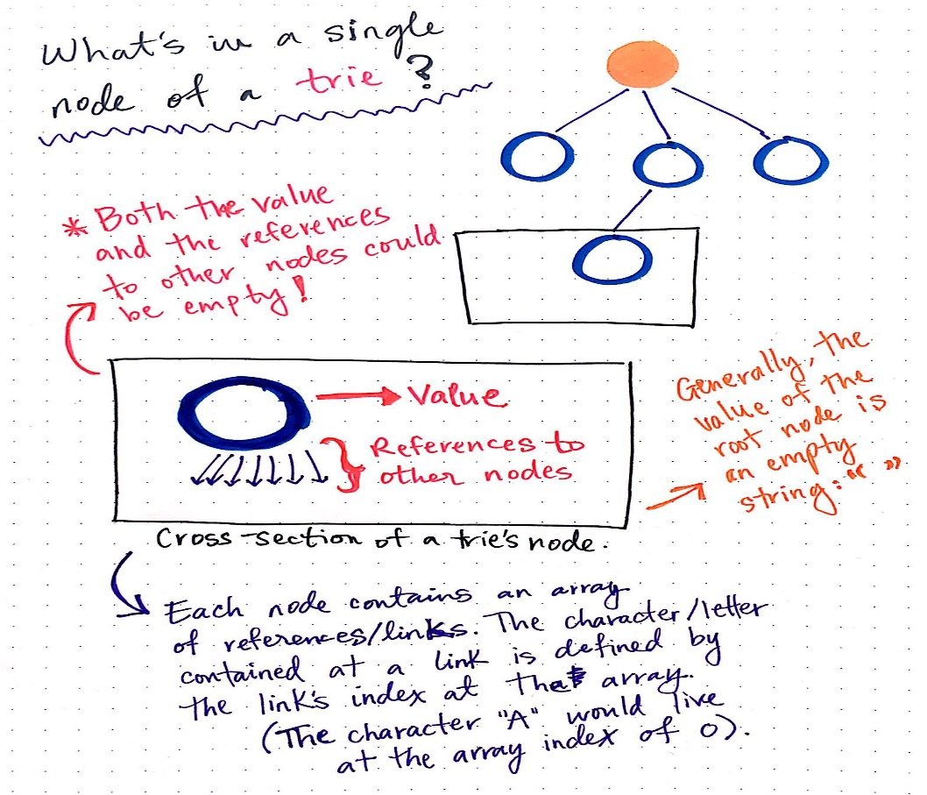
A Trie node
Declaration.
char Keytype [Maxlength]
struct trie_node
{
struct trie_node *branch[26];
Keytype *key;
}

Slide 45
Another Trie Example http://cpp.datastructures.net/presentations/Tries.pdf
The standard trie for a set of strings S is an ordered tree such that:
Each node but the root is labelled with a character
The children of a node are alphabetically ordered
The paths from the external nodes to the root yield the strings of S
stock, sell, bell, bull, bear, bid, buy, stop

Slide 46
Draw Trie
an, ant, all, allot, alloy, aloe, are, ate, be

Slide 47
Tries
A common application of a trie is storing a dictionary, such as contact list on phone.
Such applications take advantage of a trie's ability to quickly search for, insert, and delete entries;
Tries are also well suited for implementing approximate matching algorithms, including those used in spell checking software.
A special kind of trie, called a suffix tree, can be used to index all suffixes in a text in order to carry out fast full text searches.
Suitable for Data Analysis and Data Analytic Software

Slide 48
Searching
The search for a particular key begins at the root.
The first letter of the key is used as an index to determine which branch to take.
An empty branch (pointer) means that the key being sought is not in the tree. Otherwise use the second letter to determine the branch to the next level etc..
When reach the end of the word, the key pointer points to the desired information. A NULL key pointer shows that the string is not a word in the trie.

Slide 49
Insertion into a trie
Similar to searching for a key.
Must trace the way down the trie to the appropriate insertion point and set the pointer for the new key.
If, on the way, we hit a NULL branch the search is not terminated but instead new nodes must be added so as to complete the path corresponding to the new key.

Slide 50
Deletion from a trie.
Same as searching and inserting.
Trace down the path to the key being deleted and when reach the appropriate node, set the corresponding info field to NULL.
If now this node has all fields = NULL, ie branches, key fields etc, then dispose of this node.

Slide 51
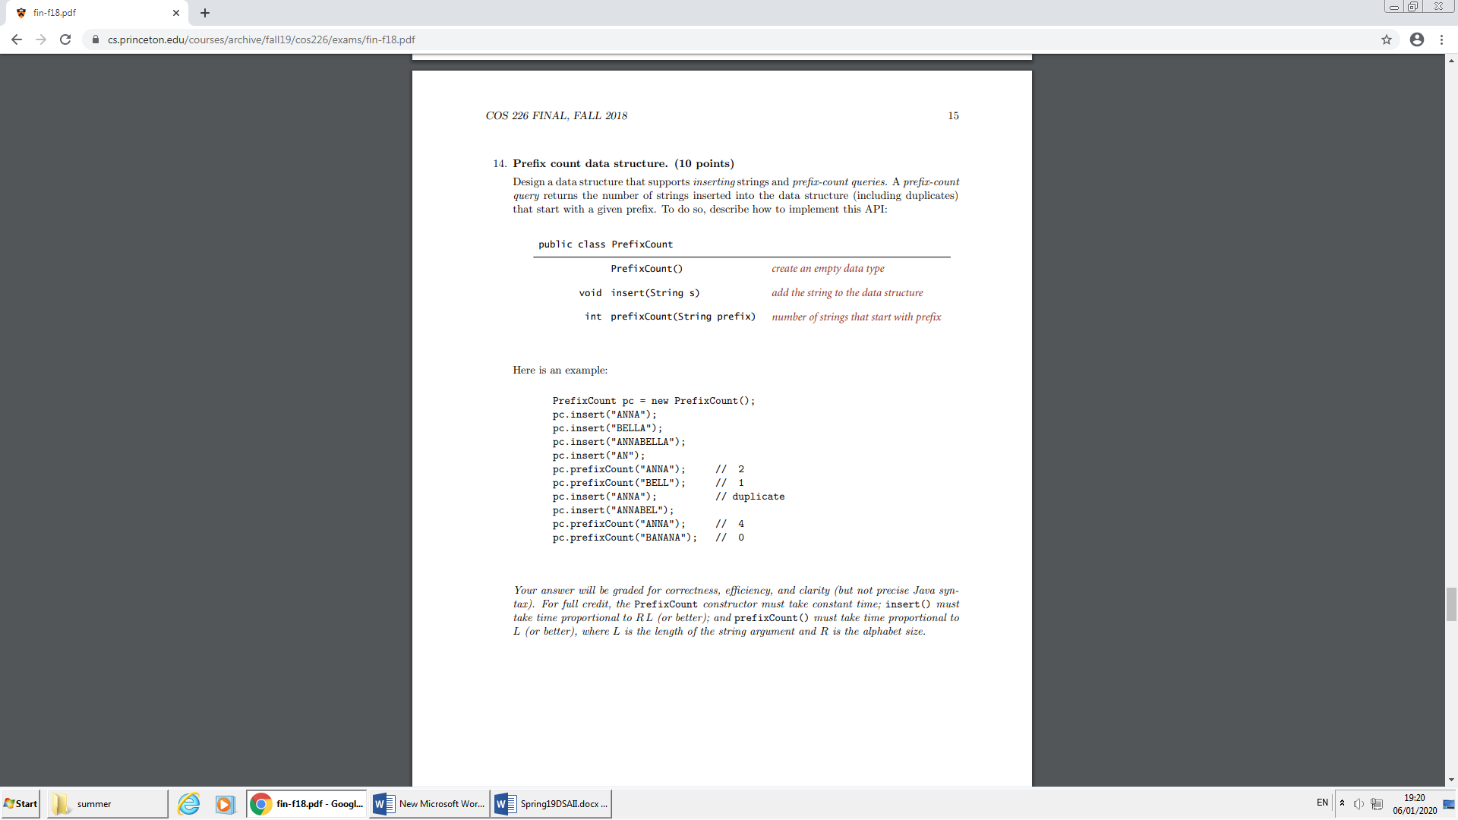
https://www.cs.princeton.edu/courses/archive/fall19/cos226/exams/fin-f18.pdf

Slide 52
Compressed Trie www.cs.umd.edu/class/fall2005/cmsc132/lecs/lec29.ppt
Approach
A chain of redundant nodes can be compressed
Replace chain with single node
Include concatenation of labels from chain
Internal node v of T is redundant if v has one child and is not the root

Slide 53
Compressed Trie
Example

Slide 54
Suffix Trie
The suffix trie of a string X is the compressed trie of all the suffixes of X
minimize
inimize
nimize
imize
mize
ize
ze
e
e
imize
inimize
ize
minimize
mize
nimize
ze

Slide 55
Reference: Suffix Trie
Reference: http://allisons.org/ll/AlgDS/Tree/Suffix/
mississippi

Slide 56
Reason for Suffix Trie
Operates on the premise that :-
Every substring of a string is a prefix of some suffix of that string
e
imize
inimize
ize
minimize
mize
nimize
ze

Slide 57
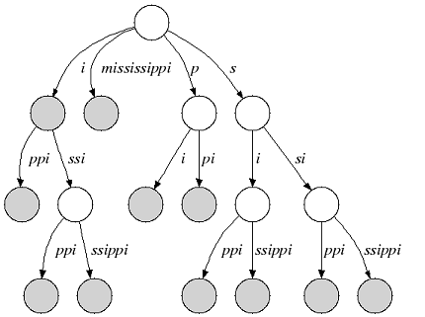
Applications : Suffix Trie
Exact String matching:
Input
Pattern P of length n
Text T of length m
Output
Position of all occurrences of P in T
Find the longest substring common to two given strings. (p and q)
E.g. The longest common substring of “piilosana” and “namiloma” is “ilo”
Exercise: The longest common substring of “bananas” and “unanalysed” is ????
Walk down the suffix tree of p, checking each suffix of q.
If you hit a dead end, save the current depth, and follow the suffix link from the current node.
When you exhaust q, return the longest substring found.

Slide 58
Applications : Suffix Trie
Count # of occurrences of q in T:
Follow the path for q starting from the root. The number of leaves under the node you end up in is the number of occurrences of q.
Find the longest repeat in T:
Find the deepest node that has at least 2 leaves under it.
Check whether q is a substring of T:
Follow the path for q starting from the root. If you exhaust the query string, then q is in T.
Check whether q is a suffix of T:
Follow the path for q starting from the root. If you end at a leaf at the end of q, then q is a suffix of T
mi?
nim?
ize?

Slide 59
Application: DNA contamination
DNA sequences of many possible contaminants are known
DNA contamination problem:
Given a string S1 (a newly sequenced DNA) and a set
of strings S (sources of possible contamination), find
all substrings of S that occur in S1 and are longer than
some given length l

Slide 60
Word Matching Trie
Insert words into trie
Each leaf stores point of occurrence of word in text

Slide 61
Tries and Web Search Engines
Search engine index is a collection of all searchable words
Stored in compressed trie
Each leaf of trie is associated with a word
List of pages (URLs) containing that word
Called occurrence list
Trie is kept in internal memory (fast)
Occurrence lists kept in external memory and are ranked by relevance
Queries on sets of words e.g. Computer, Science means set intersection operation on the occurrence lists
Other examples: Prefix matching done by routers 149.153

Slide 62
Exercises: Tries
Algorithm to delete a node from a trie.
2. Draw a trie constructed from these words
pal lap a papa al papal all ball lab
built from the letters a,b,l,p.
3. Write an app that will traverse a trie and print out all its words in alphabetical order.
4. Write an app that will traverse a trie and print out all its words with the order determined by the length of the word first and second in alphabetical order for words of the same length.

